Slide 1
Chapter 8: Complex Data Types

Slide 2
Outline
There are several non-atomic data types (multi-valued, composite..) that are widely used today. 4 categories:
Semi-Structured Data
Object Orientation
Textual Data
Spatial Data

Slide 3
1-) Semi-Structured Data
Many applications require storage of complex data, whose schema changes often, (especially web applications.)
The relational model’s requirement of atomic data types may be an overkill
E.g., storing set of interests as a set-valued attribute of a user profile may be simpler & efficient than normalizing it. (why?)
Data exchange can benefit greatly from semi-structured data
Exchange can be between applications, or between back-end and front-end of an application
Web-services are widely used today, with complex data fetched to the front-end efficiently and displayed using a mobile app or JavaScript
JSON and XML are widely used semi-structured data models

Slide 4
Features of Semi-Structured Data Models
Flexible schema
Wide column representation: allow each tuple to have a different set of attributes, can add new attributes at any time
Sparse column representation: schema has a fixed but large set of attributes, by each tuple may store only a subset
Multivalued data types
Sets, multisets
E.g.,: set of interests {‘basketball, ‘La Liga’, ‘cooking’, ‘anime’, ‘jazz’}
Key-value map (or just map for short)
Store a set of key-value pairs.
The set of specifications may be different for each product.
E.g., {(brand, Apple), (ID, MacBook Air), (size, 13), (color, silver)}
Operations on maps: put(key, value), get(key), delete(key)
Arrays
Widely used for scientific and monitoring applications

Slide 5
Features of Semi-Structured Data Models
Arrays
Widely used for scientific and monitoring applications
E.g., readings taken at regular intervals can be represented as array of values instead of (time, value) pairs
[5, 8, 9, 11] instead of {(1,5), (2, 8), (3, 9), (4, 11)}
Array database: a database that provides specialized support for arrays
E.g., compressed storage, query language extensions etc
Oracle GeoRaster, PostGIS, SciDB, etc
Multi-valued attribute types
Modeled using non first-normal-form (NFNF) data model
Supported by most database systems today

Slide 6
Nested Data Types
Hierarchical data is common in many applications
JSON: JavaScript Object Notation
Widely used today
XML: Extensible Markup Language
Earlier generation notation, still used extensively
Both provides flexibility in
the set of attributes that a record contains
the types of these attributes.
objects could have sub-objects ( tree structure)
collect different data related to a particular user into one large object (i.e. a document), allowing data to be retrieved without the need for joins.
XML is an older representation and is used by many systems mostly for storing configuration

Slide 7
JSON
Textual representation widely used for data exchange
Example of JSON data { "ID": "22222", "name": { "firstname: "Albert", "lastname: "Einstein" }, "deptname": "Physics", "children": [ {"firstname": "Hans", "lastname": "Einstein" }, {"firstname": "Eduard", "lastname": "Einstein" } ] }
Types: integer, real, string, and
Objects: are key-value maps, i.e. sets of (attribute name, value) pairs
Arrays are also key-value maps (from offset to value)

Slide 8
JSON
+ JSON is ubiquitous in data exchange today
Widely used for web services. For example, an email user interface may invoke web services for each of many tasks
Most modern applications are architected around on web services
A number of libraries are available to transform data between the JSON representation and the object representation used in languages such as JavaScript, Java, Python, PHP, and other languages.
+ SQL extensions for
JSON types for storing JSON data
Extracting data from JSON objects using path expressions
E.g. V-> ID, or v.ID
Generating JSON from relational data
E.g. json.build_object(‘ID’, 12345, ‘name’, ‘Einstein’)
Creation of JSON collections using aggregation
E.g. json_agg aggregate function in PostgreSQL
Syntax varies greatly across databases
- JSON is verbose, i.e. takes up more storage & processing time.
Compressed representations such as BSON (Binary JSON) used for efficient data storage

Slide 9
XML
XML uses tags to mark up text
E.g. <course> <course id> CS-101 </course id> <title> Intro. to Computer Science </title> <dept name> Comp. Sci. </dept name> <credits> 4 </credits> </course>
Tags make the data self-documenting
Tags can be hierarchical
The two organizations must of course agree on what tags appear in the purchase order and what they mean. DTD (document type definition) files are used for this.

Slide 10
Example of Data in XML
<purchase order> <identifier> P-101 </identifier> <purchaser> <name> Cray Z. Coyote </name> <address> Route 66, Mesa Flats, Arizona 86047, USA </address> </purchaser> <supplier> <name> Acme Supplies </name> <address> 1 Broadway, New York, NY, USA </address> </supplier> <itemlist> <item> <identifier> RS1 </identifier> <description> Atom powered rocket sled </description> <quantity> 2 </quantity> <price> 199.95 </price> </item> <item>…</item> </itemlist> <total cost> 429.85 </total cost> …. </purchase order>

Slide 11
XML Cont.
XQuery language developed to query nested XML structures
- - Not widely used currently
SQL extensions to support XML
Store XML data
Generate XML data from relational data
Extract data from XML data types
Path expressions
See Chapter 30 (online) for more information

Slide 12
Knowledge Representation
Representation of human knowledge is a long-standing goal of AI
Various representations of facts and inference rules proposed over time
RDF: Resource Description Format. (A representation standart)
Simplified representation for facts, represented as triples (subject, predicate, object)
E.g., (NBA-2019, winner, Raptors) (Washington-DC, capital-of, USA) (Washington-DC, population, 6,200,000)
Models objects that have attributes, and relationships with other objects (i.e. entities, recourses)
Like the ER model, but with a flexible schema
(ID, attribute-name, value)
(ID1, relationship-name, ID2)
Has a natural graph representation

Slide 13
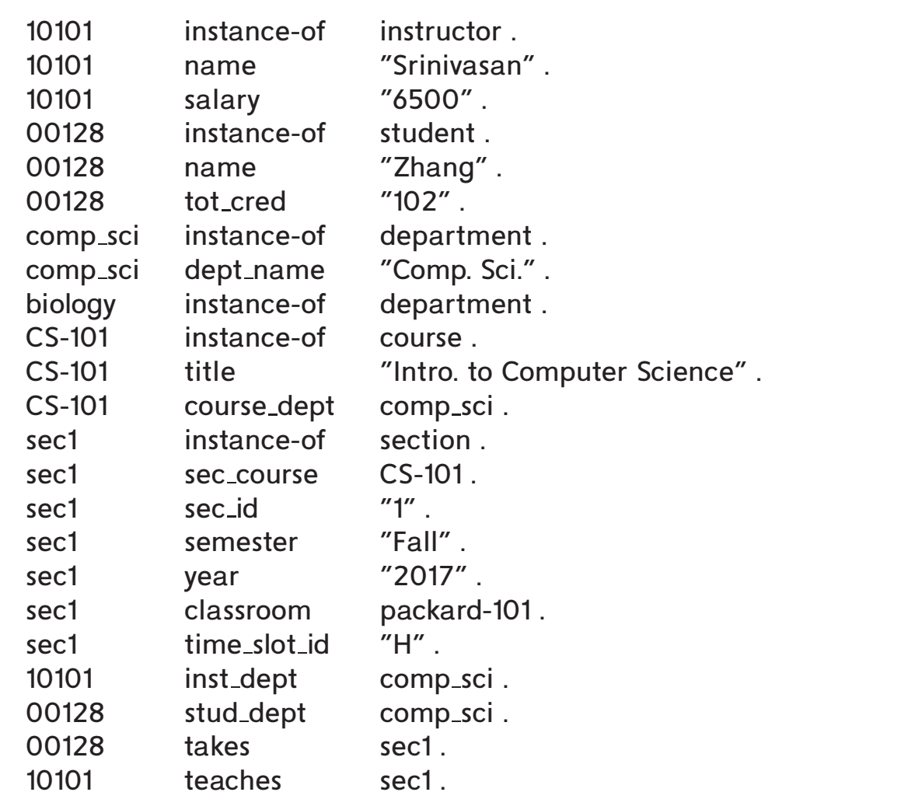
Triple Syntax of RDF Data
All attribute values are shown in "quotes".
Recourse ID,
attr. name and
relationship name are shown w/o quotes.
Relationships:
instance-of, course_dept, sec_course, classroom, takes, teaches
Entities (resources)
10101,comp_sci..
Attr name:
semester, year, sec_id,...
.
In contrast to the E-R model and relational schemas, RDF allows new attributes to
be easily added to an object and also to create new types of relationships.

Slide 14
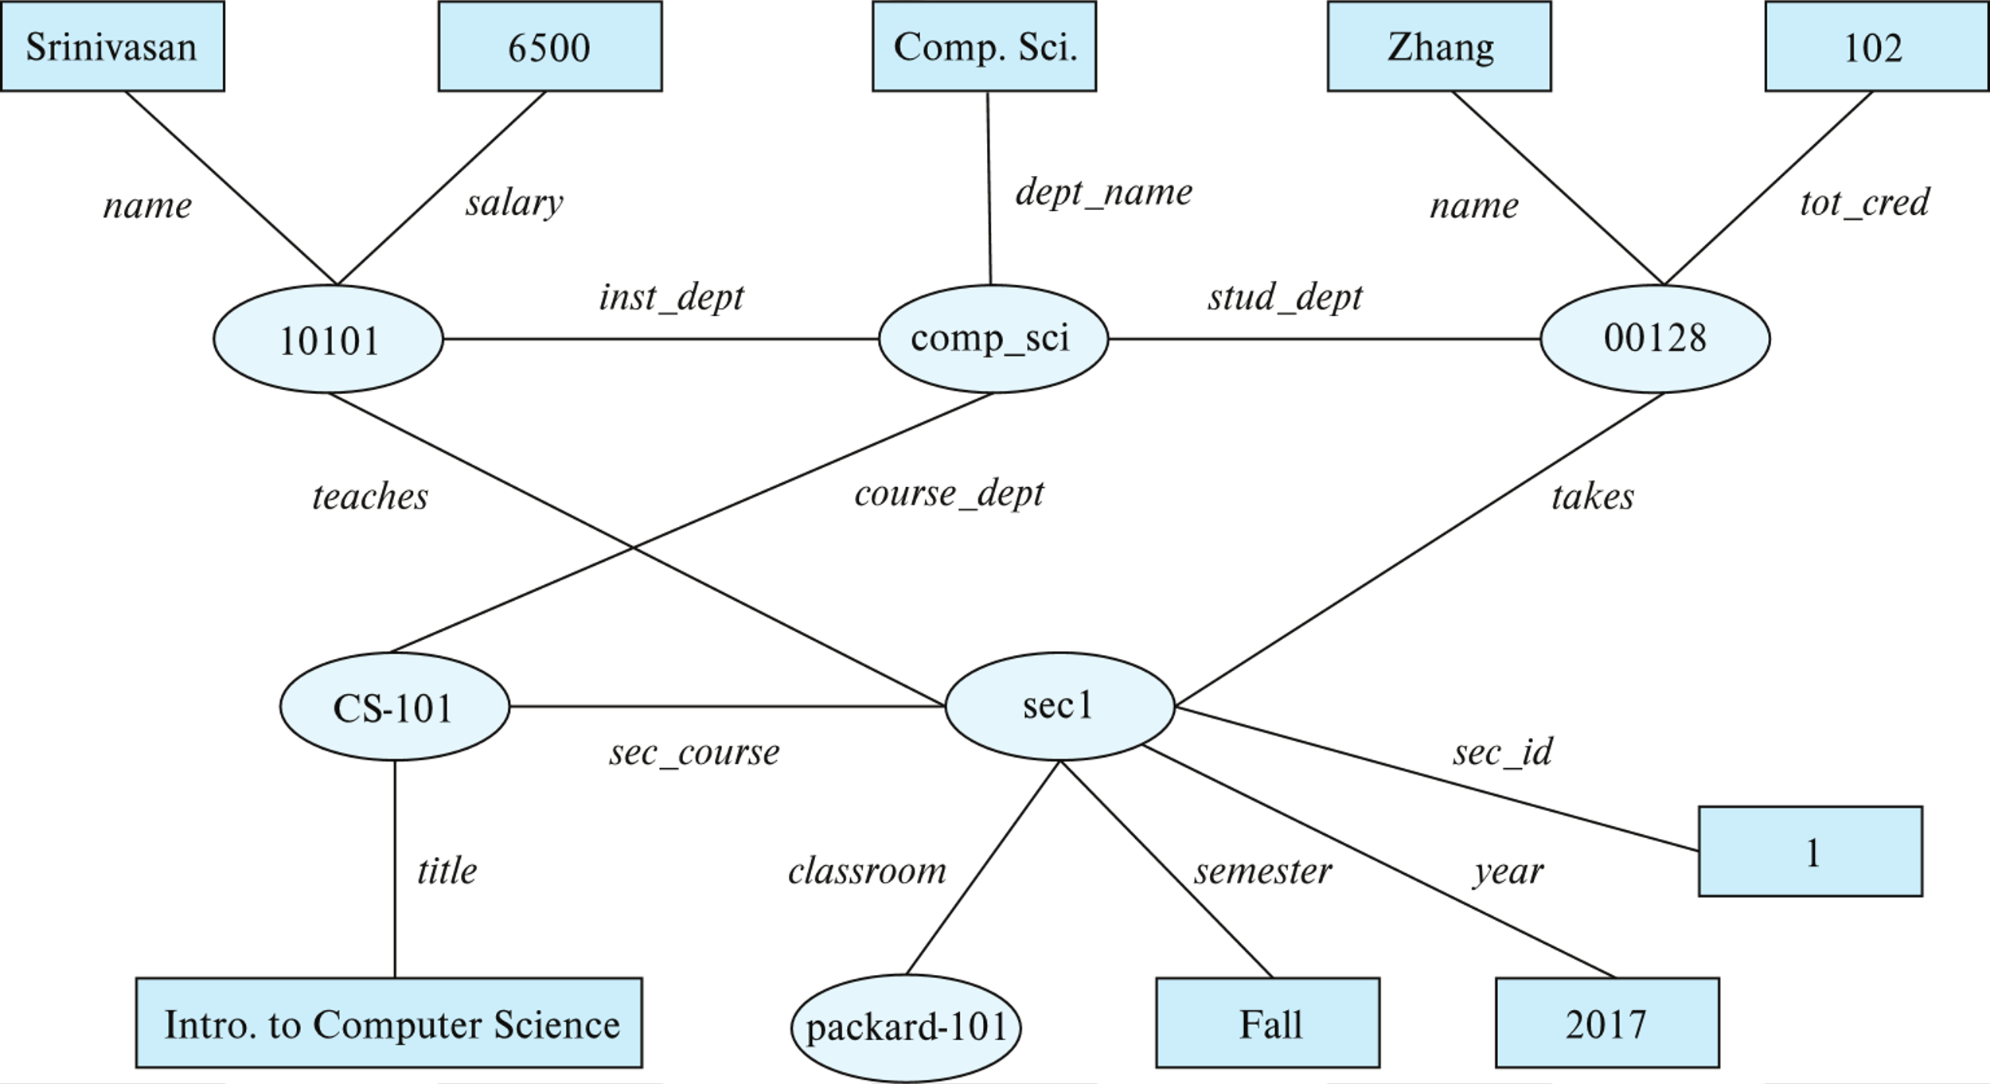
Graph View of RDF Data
Knowledge graph

Slide 15
Querying RDF: SPARQL
Triple patterns
?cid title "Intro. to Computer Science"
?cid title "Intro. to Computer Science" ?sid course ?cid
SPARQL queries
select ?name where { ?cid title "Intro. to Computer Science" . ?sid course ?cid . ?id takes ?sid . ?id name ?name . }
Also supports
Aggregation, Optional joins (similar to outerjoins), Subqueries, etc.
Transitive closure on paths

Slide 16
RDF Representation (Cont.)
RDF triples represent binary relationships
How to represent n-ary relationships?
Approach 1 (from Section 6.9.4): Create artificial entity, and link to each of the n entities
E.g., (Barack Obama, president-of, USA, 2008-2016) can be represented as (e1, person, Barack Obama), (e1, country, USA), (e1, president-from, 2008) (e1, president-till, 2016)
Approach 2: use quads instead of triples, with context entity
E.g., (Barack Obama, president-of, USA, c1) (c1, president-from, 2008) (c1, president-till, 2016)
RDF widely used as knowledge base representation
DBPedia, Yago, Freebase, WikiData, ..
Linked open data project aims to connect different knowledge graphs to allow queries to span databases

Slide 17
Outline
There are several non-atomic data types (multi-valued, composite..) that are widely used today. 4 categories:
Semi-Structured Data
Object Orientation
Textual Data
Spatial Data

Slide 18
Object Orientation
Object-relational data model provides richer type system
with complex data types and object orientation
Applications are often written in object-oriented programming languages
Type system does not match relational type system
Switching between imperative language and SQL is troublesome
Approaches for integrating object-orientation with databases
++ Build an object-relational database, adding object-oriented features to a relational database
++ Automatically convert data between programming language model and relational model; data conversion specified by object-relational mapping
-- Build an object-oriented database that natively supports object-oriented data and direct access from programming language

Slide 19
Object-Relational Database Systems
"structured" User-defined types
create type Person (ID varchar(20) primary key, name varchar(20), address varchar(20)) ref from(ID); /* More on this later */ create table people of Person;
Table types
create type interest as table ( topic varchar(20), degree_of_interest int); create table users ( ID varchar(20), name varchar(20), interests interest);
Array, multiset data types also supported by many databases
In PostgreSQL, create table N (numbers integer[]);
In Oracle, create table N (numbers varray(10) of integer );

Slide 20
Type and Table Inheritance
Type inheritance
create type Student under Person (degree varchar(20)) ; create type Teacher under Person (salary integer);
Table inheritance syntax in PostgreSQL and oracle
create table people of Person;
create table students (degree varchar(20)) inherits people; create table teachers (salary integer) inherits people;
create table people of Person; create table students of Student under people; create table teachers of Teacher under people;

Slide 21
Reference Types
Creating reference types enables to use primary key instead of system-generated ids.
create type Person (ID varchar(20) primary key, name varchar(20), address varchar(20)) ref from(ID); create table people of Person; create type Department ( dept_name varchar(20), head ref(Person) scope people); create table departments of Department insert into departments values ('CS', '12345’)
System generated references can be retrieved using subqueries
(select ref(p) from people as p where ID = '12345')
Using references in path expressions
select head->name, head->address from departments;
Alternative way (harder)::
insert into departments
values ('CS', null);
update departments
set head = (select ref(p)
from people as p
where ID = '12345')
where dept name = 'CS';

Slide 22
Object-Relational Mapping
Object-relational mapping (ORM) systems allow
Specification of mapping between programming language objects and database tuples
Automatic creation of database tuples upon creation of objects
Automatic update/delete of database tuples when objects are update/deleted
Interface to retrieve objects satisfying specified conditions
Tuples in database are queried, and object created from the tuples
++ Primary goal is to ease the job of programmers who build applications by providing them an object model while retaining the benefits of using a robust relational database underneath.
allow programmers to write queries directly on the object model; such queries are translated into SQL queries on the underlying relational database, and result objects are created from the SQL query results.
++ object-relational systems can provide significant performance gains over direct access to the underlying database by operating objects cached in primary mem.
- - suffer from significant performance inefficiencies for bulk database updates, as well as for complex queries that are written directly in the imperative language.
Bypass ORM when bulk loading & complex querying
Ex. Hibernate ORM for Java, Django ORM for Python

Slide 23
Outline
There are several non-atomic data types (multi-valued, composite..) that are widely used today. 4 categories:
Semi-Structured Data
Object Orientation
Textual Data
Spatial Data

Slide 24
3-) Textual Data
Information retrieval: querying of unstructured data
Simple model of keyword queries: given query keywords, retrieve documents containing all the keywords
More advanced models rank relevance of documents
Today, keyword queries return many types of information as answers
E.g., a query “cricket” typically returns information about ongoing cricket matches
Relevance ranking
Essential since there are usually many documents matching keywords
Different terminology in different contexts.:
the field of information retrieval, textual information is "documents"
In a database, a text-valued attribute can be considered a "document".
In the web, each web page can be considered to be a "document.".
Web search engine is a huge information retrieval system.
Submit keyword ==> web crawling
Submit a question ==> make judgements, reasoning (muhakeme)

Slide 25
Ranking using TF-IDF
Term: keyword occurring in a document/query
Term Frequency: TF(d, t), the relevance of a term t to a document d
One definition: n(d,t)
Another definition: TF(d, t) = log(1 + n(d,t)/n(d)) where
n(d,t) = number of occurrences of term t in document d
n(d) = number of terms in document d
The above notions can be formalized in more detail with place of the term occurrence in the document i.e. title, abstract, beginning, end..
Suppose a query uses two terms, “database”,“Silberschatz”. ???
Inverse document frequency: IDF(t)
One definition: IDF(t) = 1/n(t)
n(t) denotes the number of documents (among those indexed by the system) that contain the term t
Relevance of a document d to a set of terms Q
One definition: r(d, Q) = ∑_{t∈Q} TF(d, t) ∗ IDF(t)
Other definitions: user-specified weights, proximity of words in the page, Stop words?

Slide 26
Ranking Using Hyperlinks
Hyperlinks provide very important clues to importance
Google introduced PageRank, a measure of popularity/importance based on hyperlinks to pages
Pages hyperlinked from many pages should have higher PageRank
Pages hyperlinked from pages with higher PageRank should have higher PageRank
Formalized by random walk model
Let T[i, j] be the probability that a random walker who is on page i will click on the link to page j
Assuming all links are equal, T[i, j] = 1∕Ni
Ni is the number of links out of page i
Then PageRank[j] for each page j can be defined as
P[j] = δ∕N + (1 - δ) ∗ ∑_{i=1}^{N} (T[i, j] ∗ P[i])
Where N = total number of pages, and δ a constant usually set to 0.15

Slide 27
Ranking Using Hyperlinks
Definition of PageRank is circular, but can be solved as a set of linear equations
Simple iterative technique works well
Initialize all P[i] = 1/N, N is the number of pages
In each iteration use equation P[j] = δ∕N + (1 - δ) ∗ ∑_{i=1}^{N} (T[i, j] ∗ P[i]) to update P
Stop iteration when changes are small, or some limit (say 30 iterations) is reached.
Other measures of relevance are also important. Because, PageRank is a static measure, independent of the keyword query;
given a keyword query, it is used in combination with TF–IDF scores of a document to judge its relevance of the document to the keyword query.For example:
Keywords in anchor text
Number of times who ask a query click on a link if it is returned as an answer

Slide 28
Retrieval Effectiveness
Measures of effectiveness
Precision: what percentage of returned results are actually relevant
Recall: what percentage of relevant results were returned
At some number of answers, e.g. precision@10, recall@10
Keyword querying on structured data and semi-structured data i.e. knowledge bases
Useful if users don’t know schema, or there is no predefined schema.
(good news for lay users..)
Can represent data as graphs
Keywords match tuples
Keyword search returns closely connected tuples that contain keywords
E.g. on our university database given query “Zhang Katz”, Zhang matches a student, Katz an instructor and advisor relationship links them

Slide 29
Outline
There are several non-atomic data types (multi-valued, composite..) that are widely used today. 4 categories:
Semi-Structured Data
Object Orientation
Textual Data
Spatial Data

Slide 30
Spatial Data
Spatial databases store information related to spatial locations, and support efficient storage, indexing and querying of spatial data.
The syntax for representing geographic and geometric data varies by database, although representations based on the Open Geospatial Consortium (OGC) standard
Geographic data -- road maps, land-usage maps, topographic elevation maps, political maps showing boundaries, land-ownership maps, and so on.
Geographic information systems are special-purpose databases tailored for storing geographic data.
Round-earth coordinate system may be used
(Latitude, longitude, elevation)
Geometric data: design information about how objects are constructed . For example, designs of buildings, aircraft, layouts of integrated-circuits.
2 or 3 dimensional Euclidean space with (X, Y, Z) coordinates

Slide 31
Represented of Geometric Information
Various geometric constructs can be represented in a database in a normalized fashion (see next slide)
A line segment can be represented by the coordinates of its endpoints.
A polyline or linestring consists of a connected sequence of line segments and can be represented by a list containing the coordinates of the endpoints of the segments, in sequence.
Approximate a curve by partitioning it into a sequence of segments
Useful for two-dimensional features such as roads.
Some systems also support circular arcs as primitives, allowing curves to be represented as sequences of arc
Polygons is represented by a list of vertices in order.
The list of vertices specifies the boundary of a polygonal region.
Can also be represented as a set of triangles (triangulation)

Slide 32
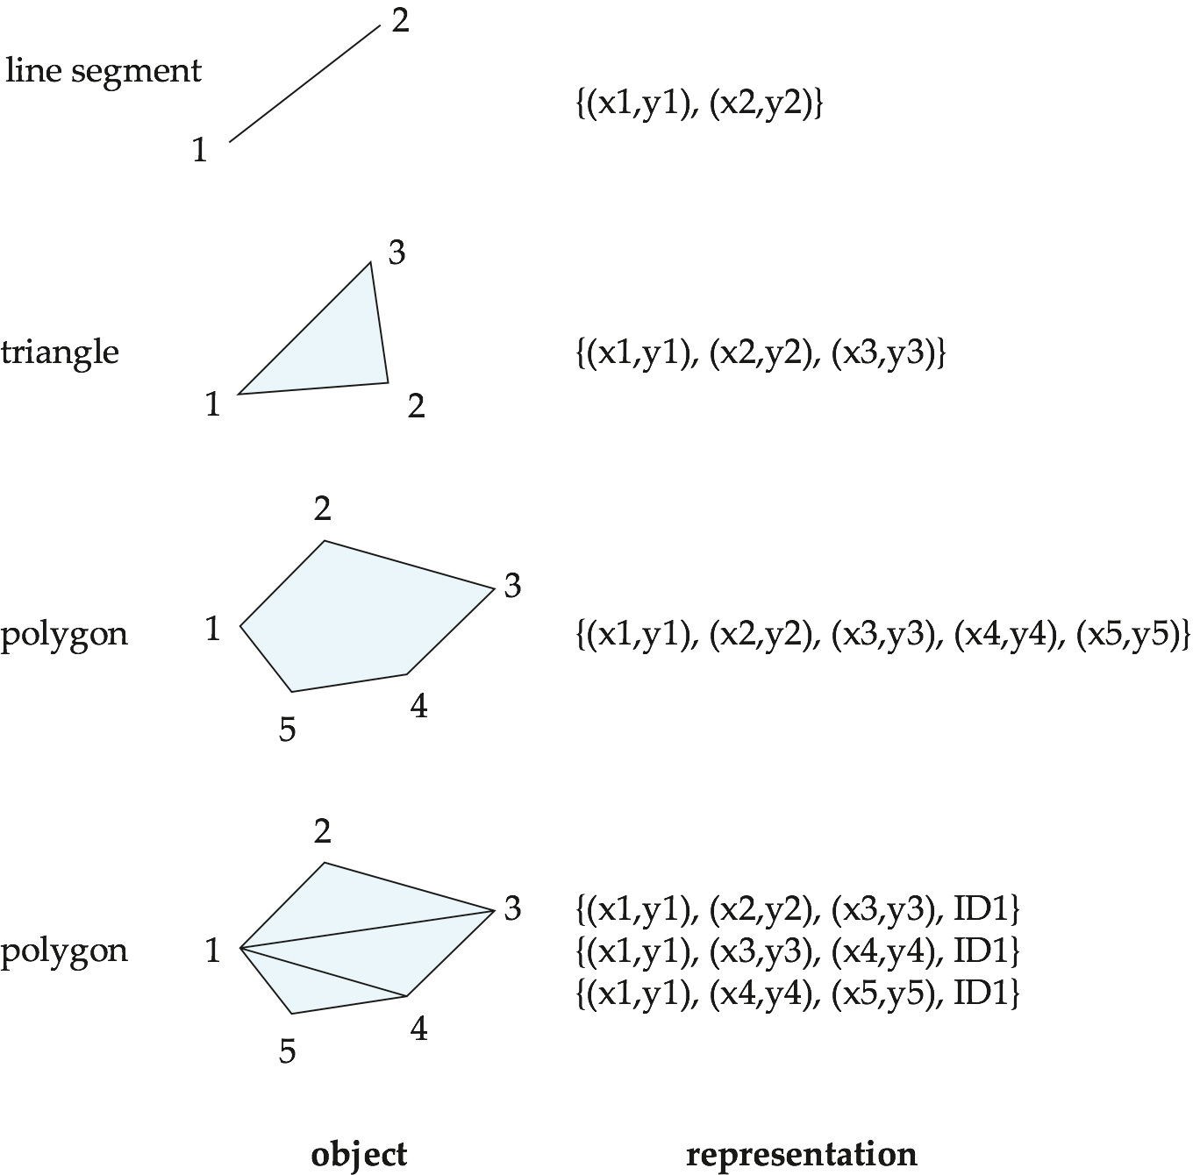
Representation of Geometric Constructs

Slide 33
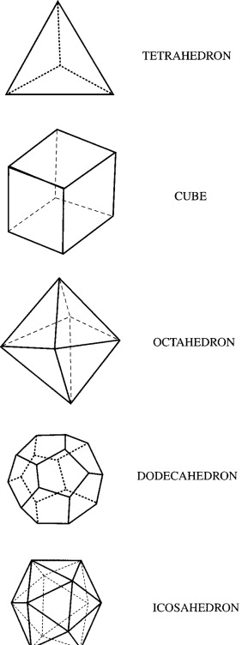
Representation of Geometric Information (Cont.)
Representation of points and line segment in 3-D similar to 2-D, except that points have an extra z component
Represent arbitrary polyhedra by dividing them into tetrahedrons, like triangulating polygons.
Alternative: List their faces, each of which is a polygon, along with an indication of which side of the face is inside the polyhedron.
Geometry and geography data types supported by many databases
E.g. SQL Server and PostGIS
point, linestring, curve, polygons
Collections: multipoint, multilinestring, multicurve, multipolygon
LINESTRING(1 1, 2 3, 4 4)
POLYGON((1 1, 2 3, 4 4, 1 1))
Type conversions: ST GeometryFromText() and ST GeographyFromText()
Operations: ST Union(), ST Intersection(), …
https://www.sciencedirect.com/topics/mathematics/polyhedron

Slide 34
Design Databases
Represent design components as objects (generally geometric objects); the connections between the objects indicate how the design is structured.
Whole project in primary mem.?
For large designs, such as the design of a large-scale integrated circuit or the design of an entire airplane, it may be impossible to hold the complete design in memory. ?
CAD systems (design DBs) ==> disk-based
Simple two-dimensional objects: points, lines, triangles, rectangles, polygons.
Complex two-dimensional objects: formed from simple objects via union, intersection, and difference operations.
Complex three-dimensional objects: formed from simpler objects such as spheres, cylinders, and cuboids, by union, intersection, and difference operations.
Wireframe models represent three-dimensional surfaces as a set of simpler objects.

Slide 35
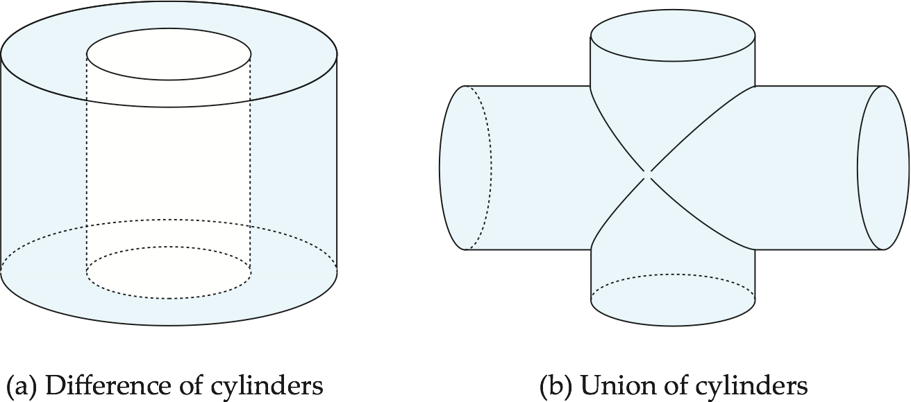
Representation of Geometric Constructs
Design databases also store non-spatial information about objects (e.g., construction material, color, etc.)
Spatial integrity constraints are important.
E.g., pipes should not intersect, wires should not be too close to each other, etc.
Importance of Spatial indexes !!

Slide 36
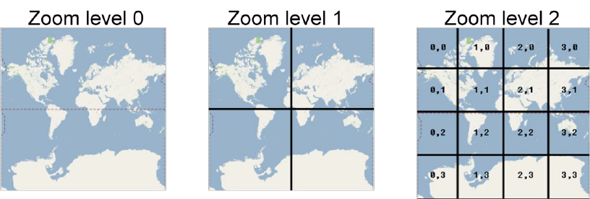
Geographic Data
variety of uses:
(online) map: boundaries, rivers, and roads, for example—but also detailed information associated with locations, such as elevation, soil type,land usage, and annual rainfall.
navigation services,
distribution-network information for public-service utilities (i.e. telephone, electric-power, and water-supply)
Raster data consist of bit maps or pixel maps, in two or more dimensions.
Raster data are often represented as tiles, each covering a fixed-size area.
Example 2-D raster image: satellite image of cloud cover, where each pixel stores the cloud visibility in a particular area.
Additional dimensions might include the temperature at different altitudes at different regions, or measurements taken at different points in time.
https://carpentries-incubator.github.io/jupyter_maps/02-raster/index.html

Slide 37
Geographic Data (Cont.)
Vector data are constructed from basic geometric objects: points, line segments, triangles, and other polygons in two dimensions, and cylinders, spheres, cuboids, and other polyhedrons in three dimensions.
Vector format often used to represent map data.
Roads can be considered as two-dimensional and represented by lines and curves.
Some features, such as rivers, may be represented either as complex curves or as complex polygons, depending on whether their width is relevant.
Features such as regions and lakes can be depicted as polygons.
Topographical information, that is information about the elevation (height) of each point on a surface, can be represented in raster or vector form::.
by dividing the surface into polygons covering regions of (approximately) equal elevation,
Or TIN (triangulated irregular network): triangles represented by the latitude, longitude, and elevation of each of its corners.

Slide 38
Spatial Queries
Region queries deal with spatial regions. e.g., ask for objects that lie partially or fully inside a specified region
E.g., PostGIS ST_Contains(), ST_Overlaps(), …
Nearness queries request objects that lie near a specified location.
Nearest neighbor queries, given a point or an object, find the nearest object that satisfies given conditions.
Spatial graph queries request information based on spatial graphs
E.g., shortest path between two points via a road network
Spatial join of two spatial relations with the location playing the role of join attribute.
Queries that compute intersections or unions of regions

Slide 39
End of Chapter 8

